Slide 1







Navigating Tech Trends: Unveiling Insights through Data Analysis and Visualization
Luis A. Gil Lares
February 2024

Slide 2



OUTLINE
Executive Summary
Introduction
Methodology
Results
Visualization – Charts
Dashboard
Discussion
Findings & Implications
Conclusion
Appendix

Slide 3

EXECUTIVE SUMMARY
• Current Technology Trends
• Future Technology
Language
Database
Platform
• Web Frame
• Demographics Survey
• Technology gap in countries
• Gender Gap in jobs

Slide 4

INTRODUCTION
About:
The focus is on analyzing trends in technology to stay ahead of the curve in an ever-evolving landscape.
Purpose:
Identify Skill Requirements:
Analyze data to pinpoint the skills essential for future success in the technological domain.
Identify Future Technologies:
Uncover emerging technologies poised to shape the future landscape of IT solutions.
Top Technologies Used by Programmers:
Delve into data to discern the most in-demand programming languages and technologies.
Popular Platforms Used:
Explore the prevalent platforms and tools preferred by developers and IT professionals.

Slide 5

METHODOLOGY
Data Collection:
Gathering information from various sources including job postings, training portals, and surveys to obtain a comprehensive dataset.
Data Exploration:
Delving into the collected data to understand its structure, quality, and potential insights it holds.
Data Wrangling:
Cleaning, transforming, and preparing the data for analysis to ensure its suitability for further exploration.
Data Visualization:
Utilizing visualizations to present key findings, trends, and patterns in the data in a clear and impactful manner.
Presentation:
Compiling insights and visualizations into a cohesive presentation format to effectively communicate findings and recommendations.

Slide 6
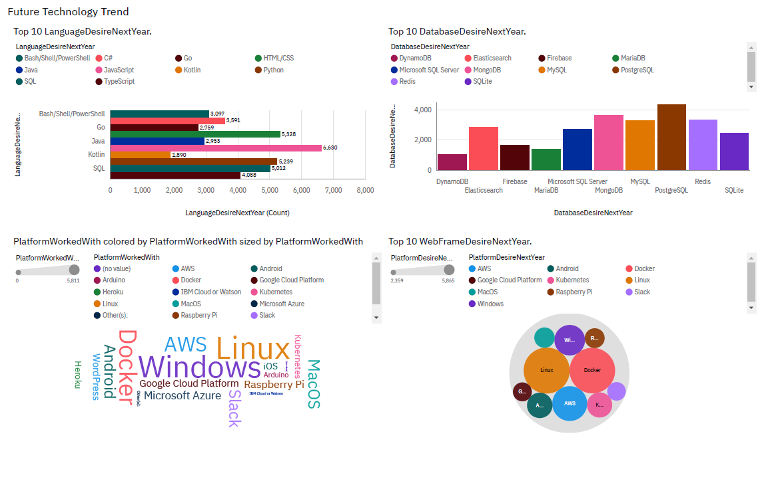
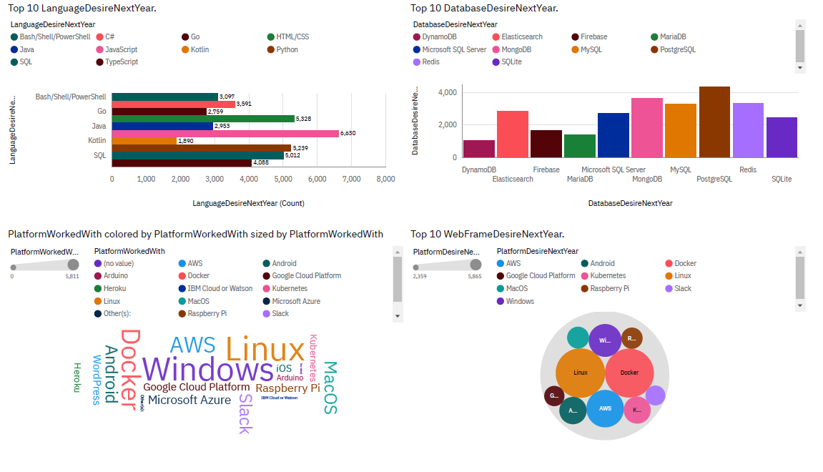
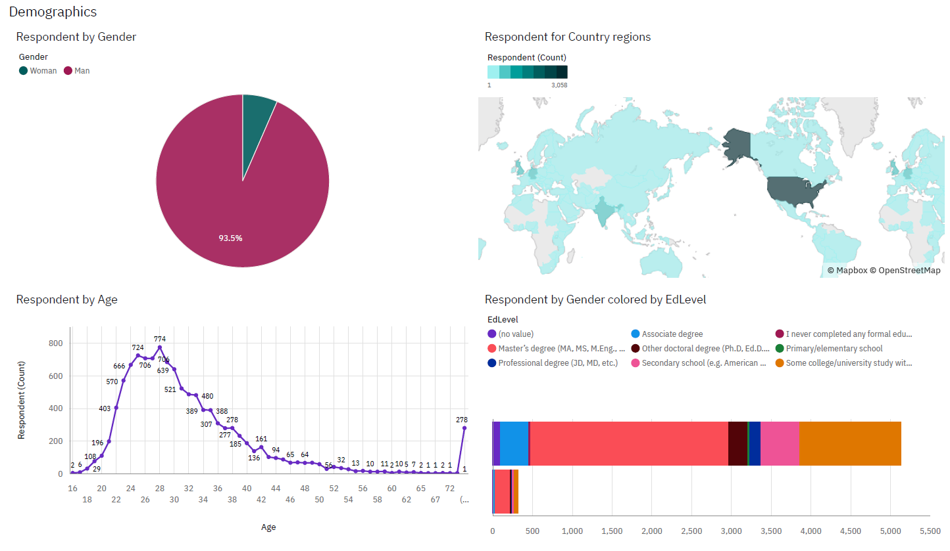
RESULTS

Slide 7
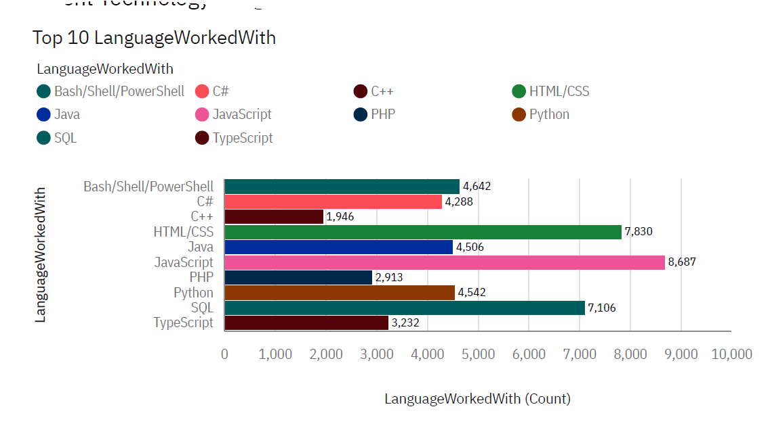
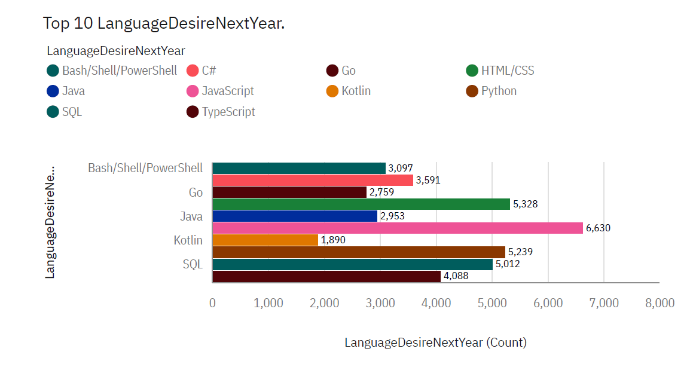
PROGRAMMING LANGUAGE TRENDS

Slide 8
PROGRAMMING LANGUAGE TRENDS - FINDINGS & IMPLICATIONS
Findings
Top Programming Languages:
JavaScript, HTML/CSS, and SQL emerge as the top three in the current year, indicating their continued relevance and demand in the market.
Emerging Trends:
Python demonstrates a notable increase in popularity as a desired language for the upcoming year, signifying its growing importance in the tech industry.
Declining Popularity:
PowerShell experiences a decrease in popularity in the coming year, suggesting a shift in preferences or technological advancements impacting its usage.
Implications
Web Development Continues High Demand:
The prominence of JavaScript and HTML/CSS underscores the ongoing demand for web development skills, indicating sustained opportunities in this field.
Python Emerges as Top Choice for Future Technology:
The increasing popularity of Python suggests it as a prime candidate for future technology adoption, owing to its versatility and widespread applicability across various domains.
SQL Maintains High Demand:
SQL's enduring relevance and high demand highlight its critical role in data management and analytics within companies, reaffirming its importance in organizational operations.

Slide 9
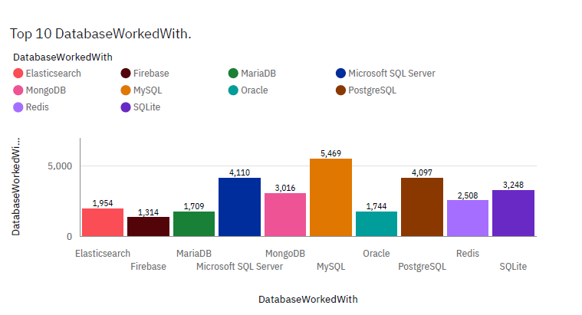
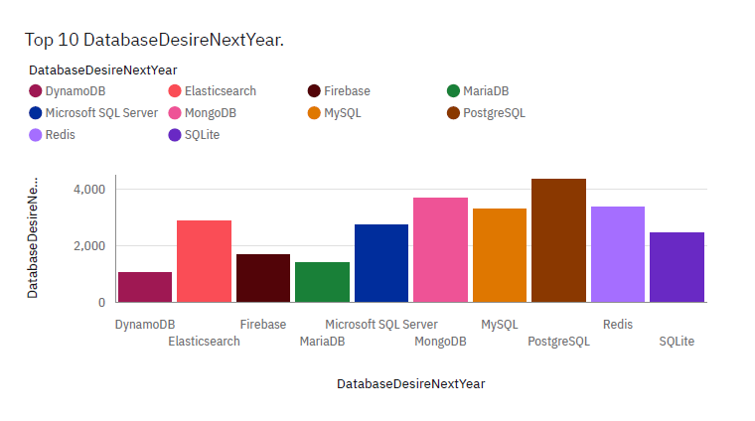
DATABASE TRENDS

Slide 10
DATABASE TRENDS - FINDINGS & IMPLICATIONS
Findings
Finding 1
Finding 2
Finding 3
Implications
Implication 1
Implication 2
Implication 3

Slide 11

DASHBOARD
https://github.com/luisgil1989/IBM-Coursera-Data-Analytics-capstone-project/blob/main/IBM%20Data%20analytics%20project%20Cognis%20Dashboard.pdf

Slide 12
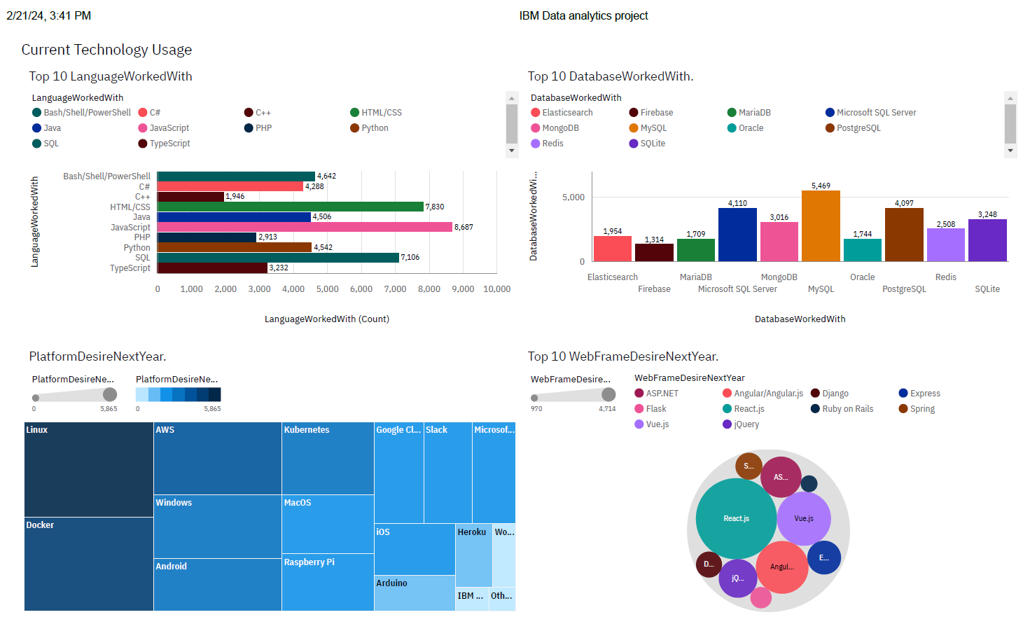
DASHBOARD TAB 1

Slide 13
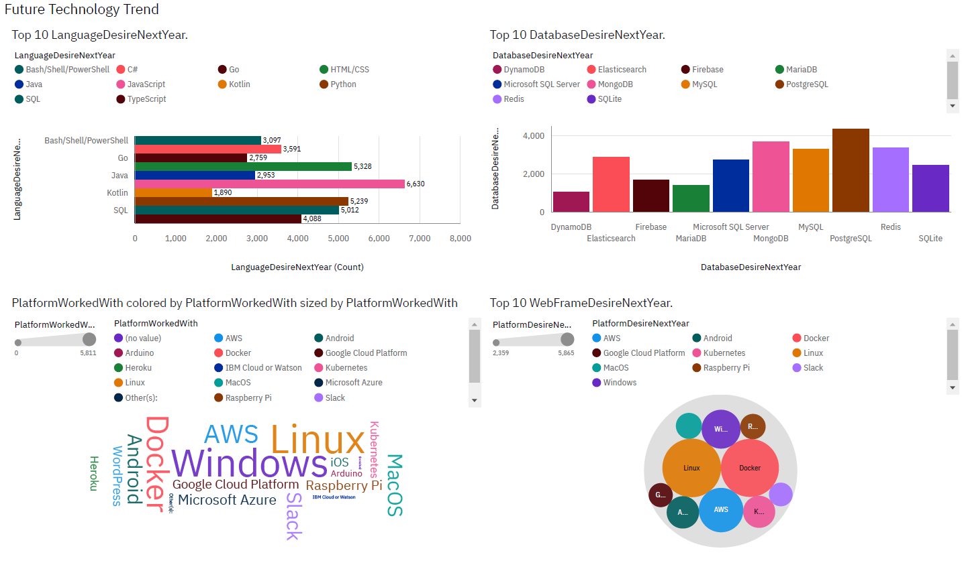
DASHBOARD TAB 2

Slide 14
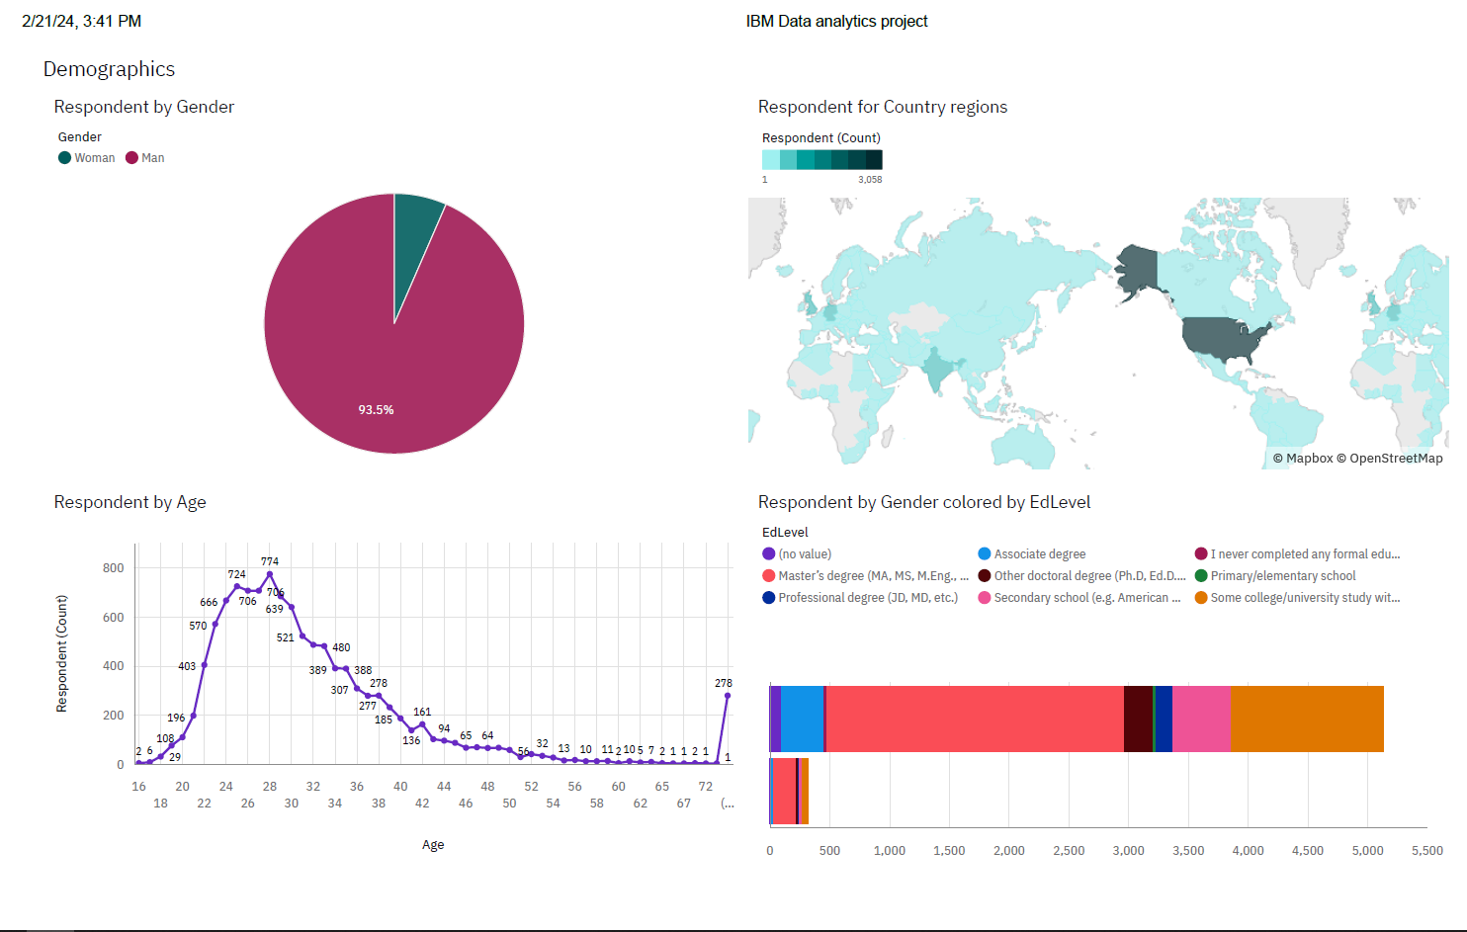
DASHBOARD TAB 3

Slide 15
DISCUSSION
Reskilling Workers:
Addressing the need to reskill workers to keep pace with evolving technology trends, ensuring workforce readiness and organizational adaptability.
Gender Equality:
Exploring strategies to promote gender equality and diversity in the tech industry, fostering inclusive workplaces and leveraging diverse perspectives for innovation.
Adaptation of New Technology:
Discussing challenges and opportunities associated with the adoption of new technologies, including implementation strategies, overcoming resistance, and managing transitions.
Using Popular Platforms:
Examining the benefits and considerations of leveraging popular platforms and tools in technology projects, optimizing efficiency, and staying aligned with industry standards.
Hiring New Tech Workers:
Addressing the recruitment and retention of new tech workers, including strategies for talent acquisition, skills assessment, and creating conducive work environments to attract top talent.

Slide 16
OVERALL FINDINGS & IMPLICATIONS
Findings
Rapidly Changing Technology Landscape:
Highlighting the dynamic nature of technology trends, necessitating continuous adaptation and learning to stay relevant in the industry.
Focus on Key Countries: USA and India:
Noting the concentration of technological developments and opportunities in countries like the USA and India, indicating pivotal roles in driving global innovation and growth.
Age and Gender Disparities:
Identifying disparities in age and gender within the tech industry, underscoring the need for initiatives to bridge these gaps and promote inclusivity.
Rising Popularity of AWS and Docker:
Observing the increasing adoption and popularity of cloud computing services like AWS and containerization tools like Docker, reflecting shifting preferences and technological advancements in infrastructure management.
Implications
Adoption of New Technologies by Companies:
Encourage companies to embrace new technologies to stay competitive, innovate, and meet evolving market demands.
Implementation of Schemes to Bridge Age and Gender Gap:
Advocate for the introduction of schemes and initiatives aimed at reducing age and gender disparities in the tech industry, fostering diversity and inclusivity.
Expansion of Hiring for New Technology Jobs:
Suggest increasing hiring efforts for roles related to emerging technologies to meet the growing demand and fill skill gaps in the workforce.
Utilization of Docker and Cloud (AWS) for Application Deployments:
Promote the use of Docker and cloud services like AWS for efficient, scalable, and cost-effective deployment of applications, enabling streamlined operations and enhanced flexibility.

Slide 17

CONCLUSION
Embrace Technological Evolution:
In a rapidly changing landscape, companies must adapt to new technologies to remain competitive and meet evolving market demands.
Prioritize Diversity and Inclusion:
Bridging age and gender gaps is essential for fostering a diverse and inclusive tech workforce, driving innovation and fostering a supportive environment for all.
Invest in Talent Acquisition and Development:
Increasing hiring for new technology roles and implementing reskilling programs are vital for addressing skill shortages and ensuring workforce readiness in the face of technological advancements.
Leverage Cloud and Containerization Technologies:
The adoption of cloud services like AWS and containerization tools like Docker can streamline application deployments, enhance scalability, and optimize resource utilization.
Strategic Planning for Future Success:
By embracing new technologies, promoting diversity, investing in talent, and leveraging advanced deployment strategies, organizations can position themselves for sustained growth and success in the dynamic tech landscape.

Slide 18
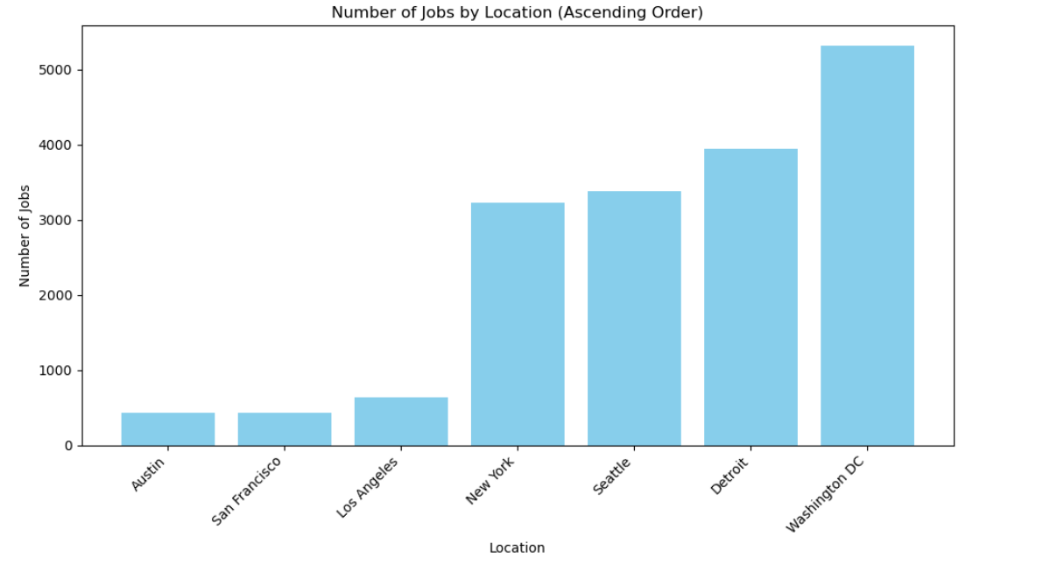
JOB POSTINGS

Slide 19
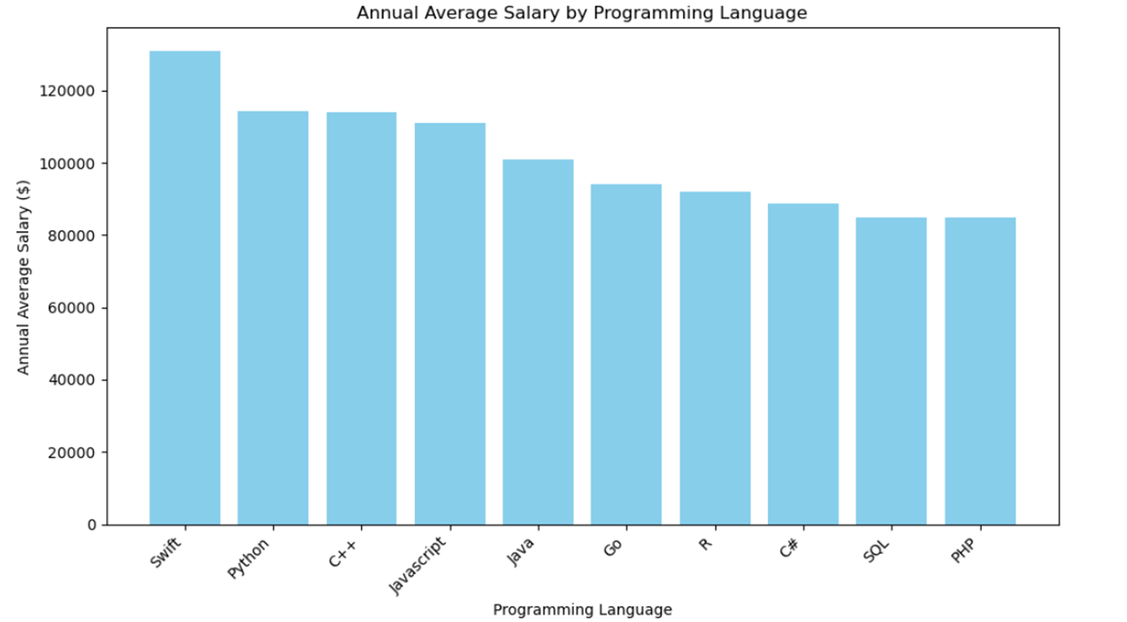
POPULAR LANGUAGES

